Slide 1

PANIMALAR ENGINEERING COLLEGE
Department of Mechanical Engineering
Presentation on
Cooling systems in
Internal Combustion Engine
Presentation by
- S.V Ragul & S. Munishwaran
2nd year B.E Mechanical

Slide 2
PANIMALAR ENGINEERING COLLEGE
Department of Mechanical Engineering
Cooling of Internal Combustion Engines
The Engine cooling is one of the most important system that is present in the Internal Combustion Engine to reduce the temperature of the components inside the engine. It also helps to reduce the wear out of the component and provide smooth functioning and long life of the components.
Types of Cooling System:
Generally, there are two types of the cooling system, and those are:
Air Cooling System
Water Cooling System
Page 2 of 13

Slide 3
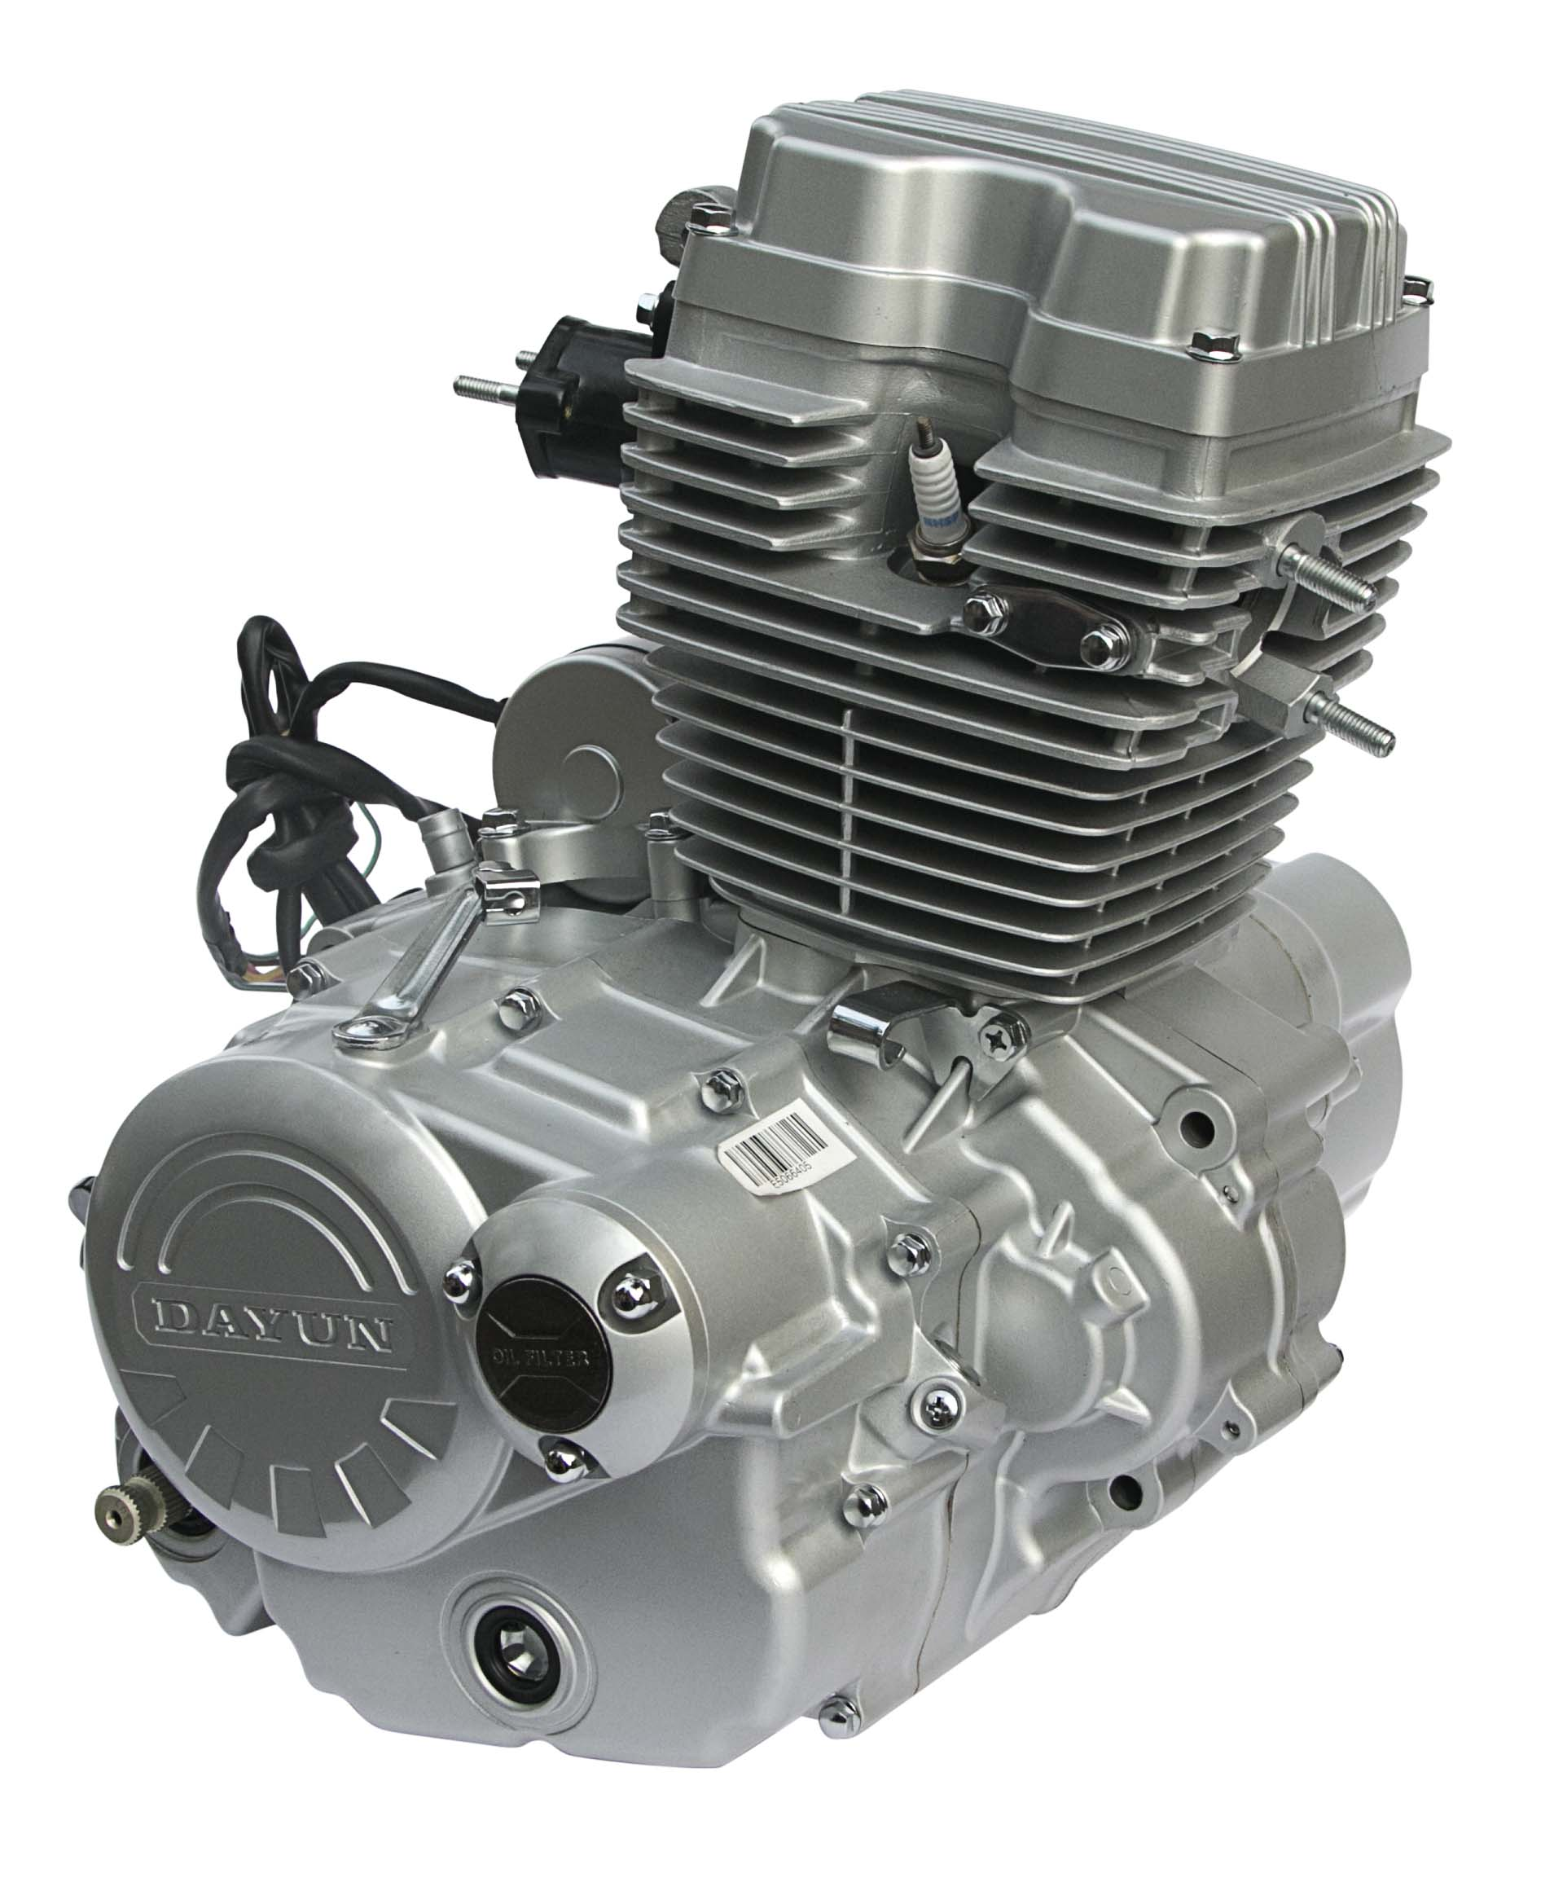
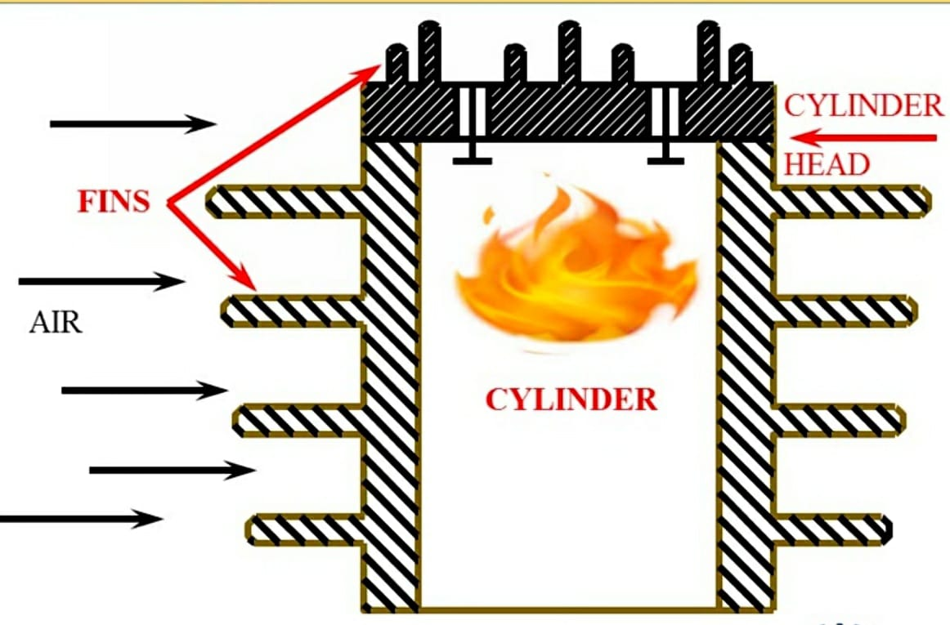
PANIMALAR ENGINEERING COLLEGE
Department of Mechanical Engineering
Air Cooling System:
Air cooling is a process of lowering air temperature by dissipating heat it provide Increased air flow and reduced temperatures with the use of cooling fins, fans or finned coils That move the heat out of the piston jackets.
Page 3 of 13

Slide 4
PANIMALAR ENGINEERING COLLEGE
Department of Mechanical Engineering
Applications of Air Cooling System:
Air cooling is commonly used in:
Motorcycles
General aviation aircraft
Lawn mowers
Generators
Outboard motors
Pump sets
Saw benches and
Auxiliary power units.
Page 4 of 13

Slide 5
PANIMALAR ENGINEERING COLLEGE
Department of Mechanical Engineering
Liquid Cooling System:
This type is the most commonly used type of system in I.C engines. In this system dissipation of heat is done by the circulation of water through the jackets around the Cylinder and passes this hot water through the radiator where air absorbs heat from the water.
Parts of Water Cooling System are:
Radiator.
Thermostat valve
Water pump
Fan
Water Jackets
Coolant
Page 5 of 13

Slide 6
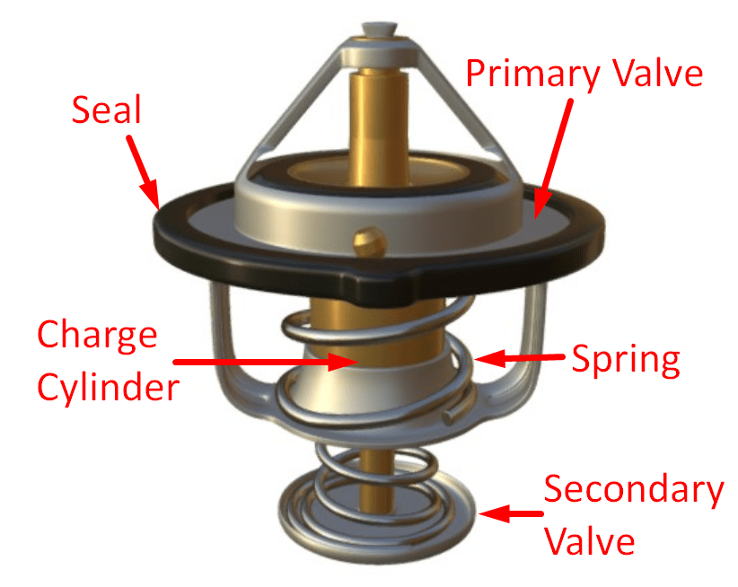
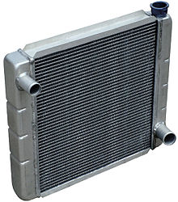
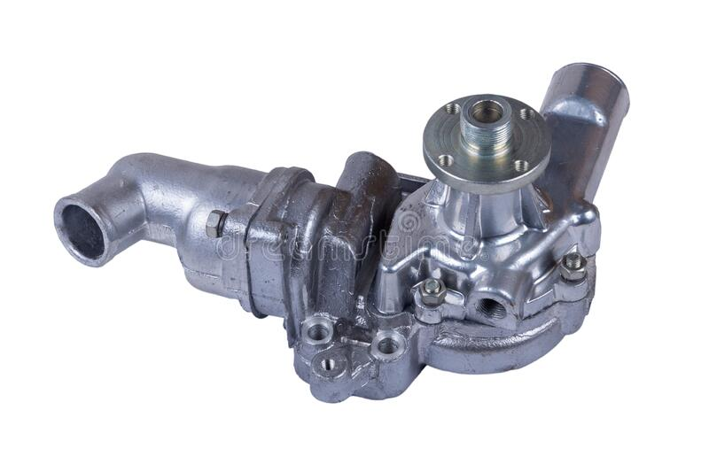
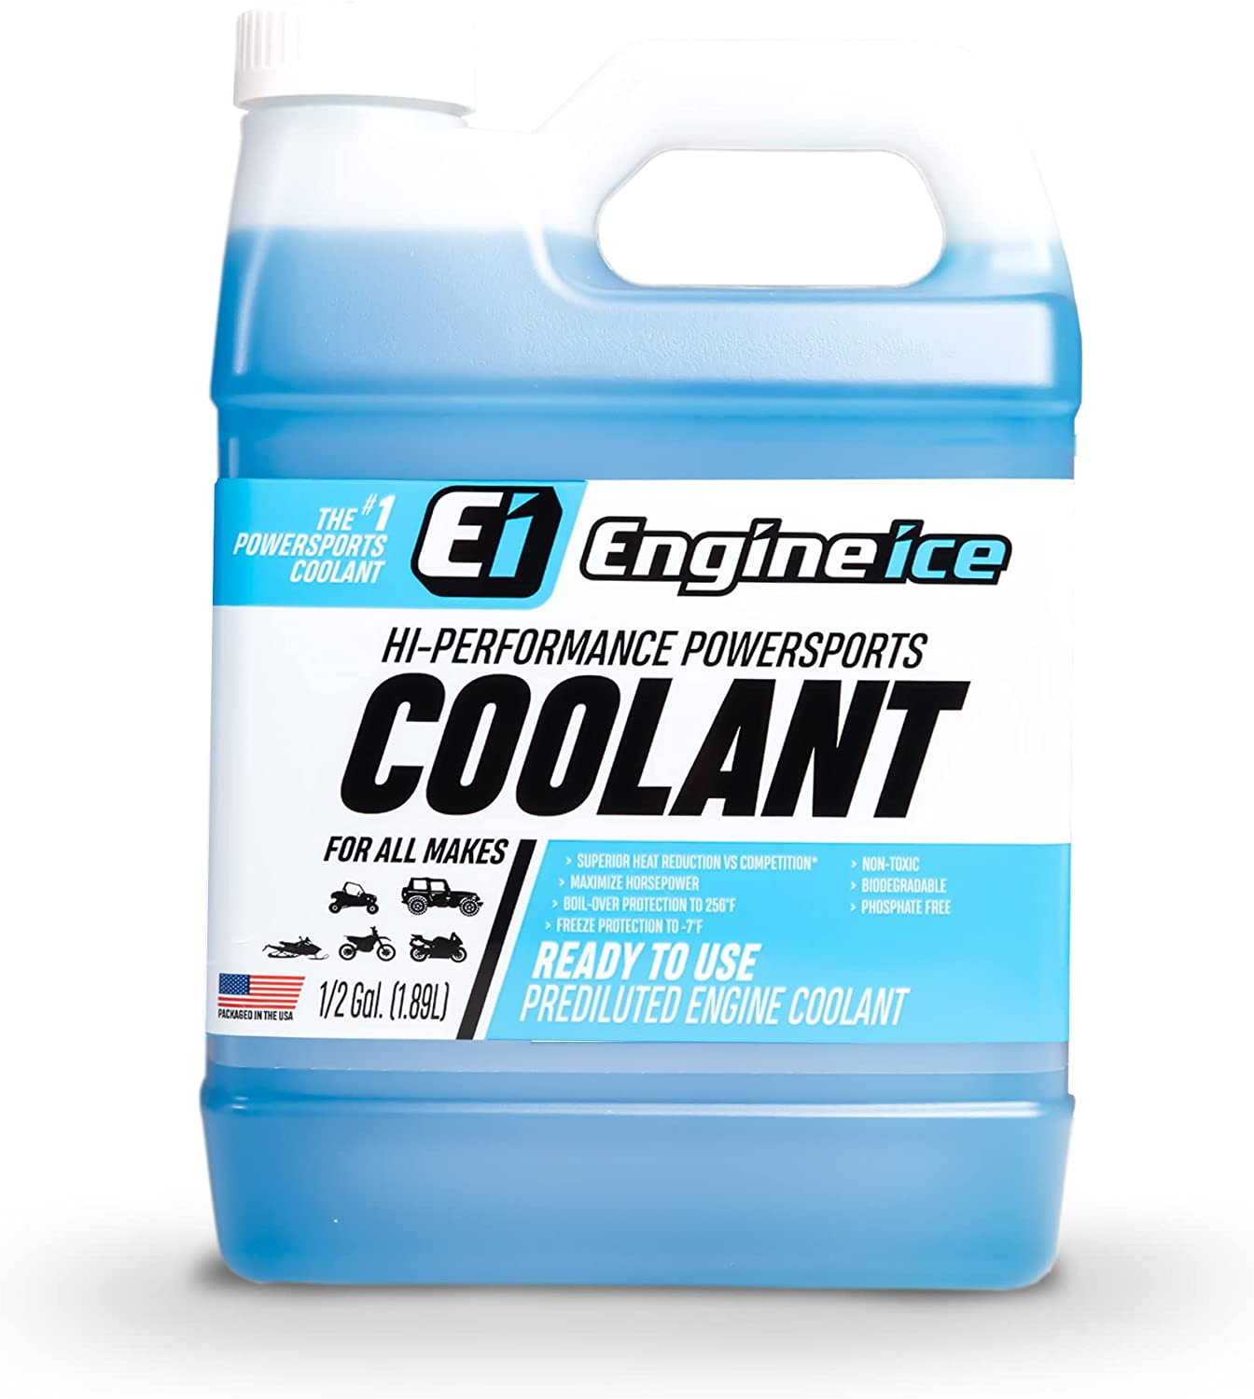
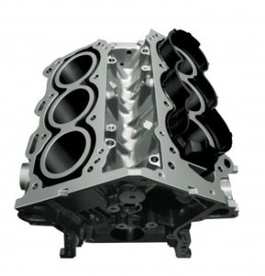
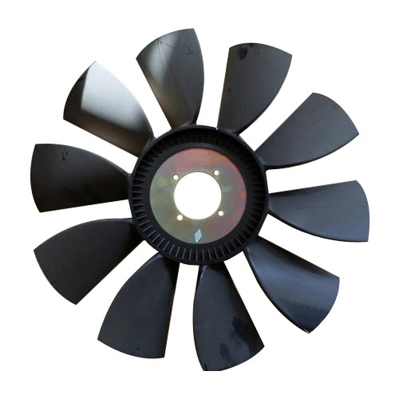
PANIMALAR ENGINEERING COLLEGE
Department of Mechanical Engineering
Parts of Water Cooling System
Thermostat
Valve
Radiator
Water Pump
Coolant
Water Jackets
Fan
Page 6 of 13

Slide 7
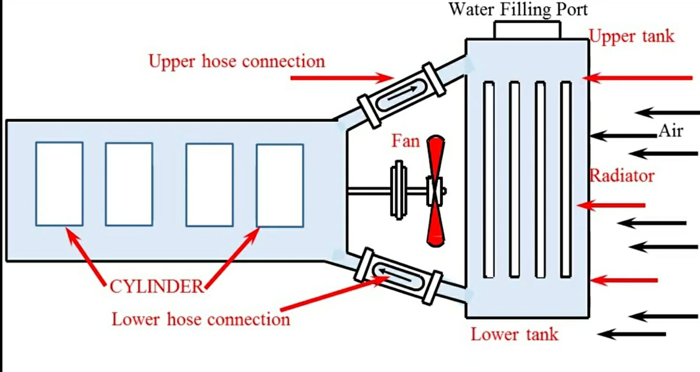
PANIMALAR ENGINEERING COLLEGE
Department of Mechanical Engineering
Types of Liquid Cooling System:
Thermo-Syphon Cooling:
A thermo-siphon is a passively driven thermal management device that utilizes the motive forces of natural convection and conduction. The device uses these forces to create a cyclic fluid flow from areas of high heat to low heat and back. It is most commonly used in refrigerators.
Page 7 of 13

Slide 8
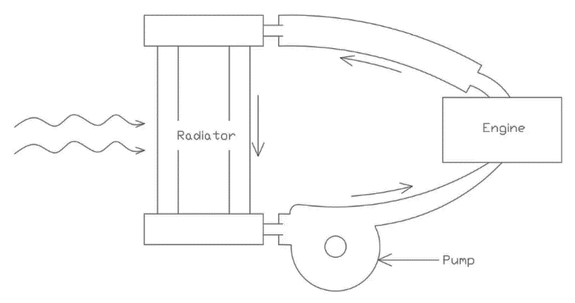
PANIMALAR ENGINEERING COLLEGE
Department of Mechanical Engineering
Forced or Pump Cooling:
Forced-air cooling is accomplished by exposing packages of produce in a cooling room to higher air pressure on one side than on the other. This pressure difference forces the cool air through the packages and past the produce, where it picks up heat, greatly increasing the rate of heat transfer
Page 8 of 13

Slide 9
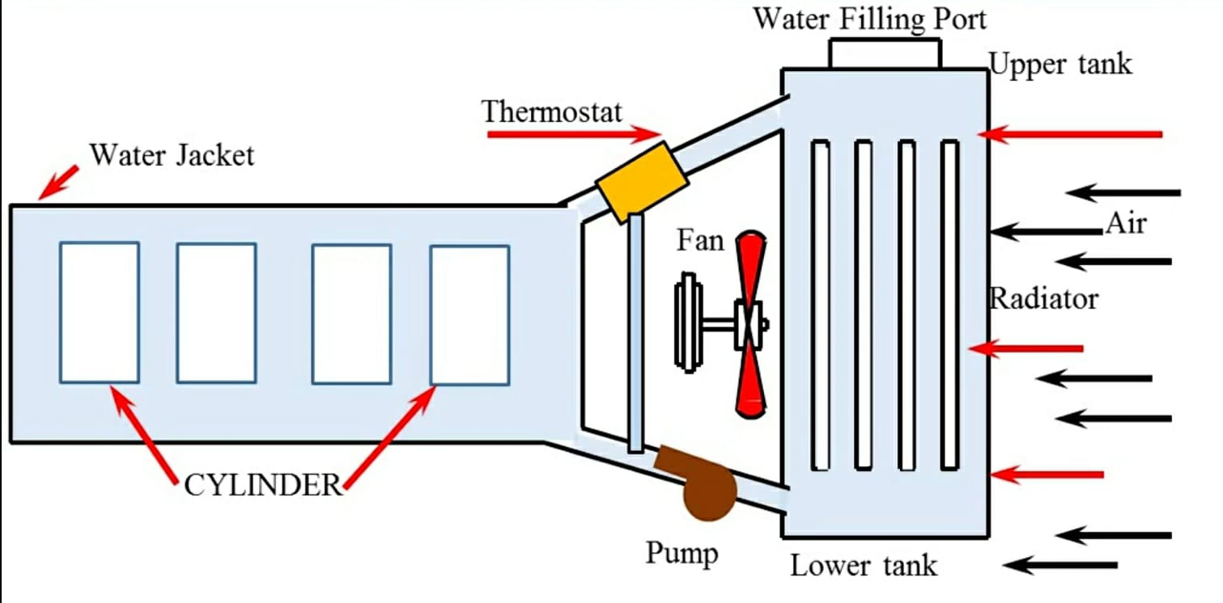
PANIMALAR ENGINEERING COLLEGE
Department of Mechanical Engineering
Thermostat Cooling:
A thermostat is the key component of the engine cooling system. The cooling system keeps the engine from overheating. The system is filled with liquid coolant (antifreeze) and is connected into a loop with a radiator to reduce the heat from the jackets. It is commonly used in cars, trucks etc.
Page 9 of 13

Slide 10
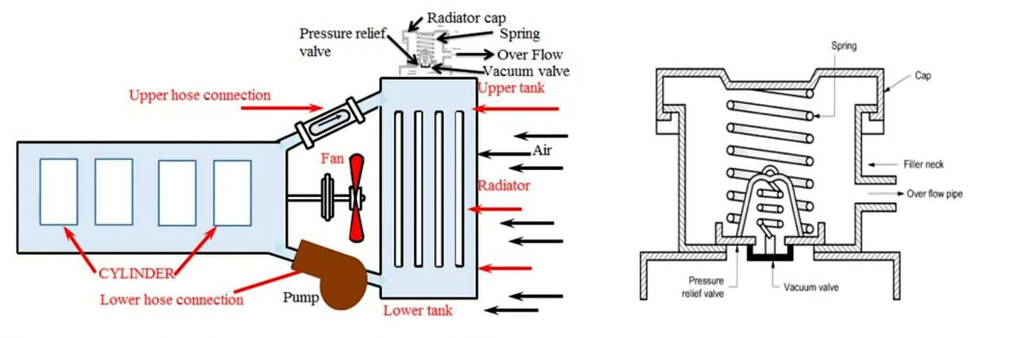
PANIMALAR ENGINEERING COLLEGE
Department of Mechanical Engineering
Pressurized Water Cooling:
The pressurized cooling systems keep the water in contact with hottest parts of the engine. Because the system is air-free and under pressure, there are no steam pockets that form hot spots allowing you to run longer and hotter.
Page 10 of 13

Slide 11
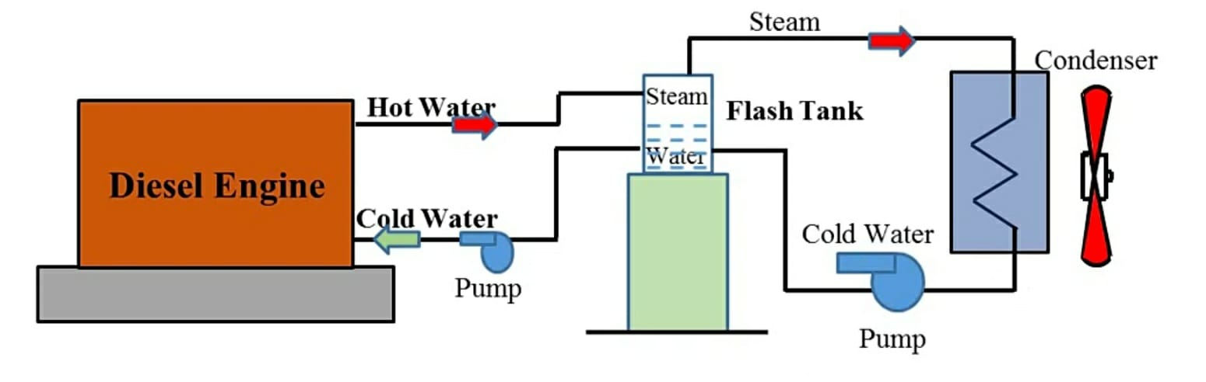
PANIMALAR ENGINEERING COLLEGE
Department of Mechanical Engineering
Evaporative Cooling:
This is predominately used in stationary engine. In this the engine will be cooled because of the evaporation of water in the cylinder jackets into the steam. Here the advantage is taken from the high latent heat of vaporizing of the water by allowing evaporation in the cylinder jackets. If the steam is formed at a pressure above the atmosphere, the temperature will be above the normal permissible temperature.
Page 11 of 13

Slide 12
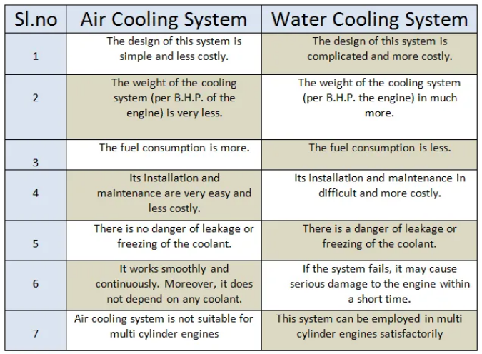
PANIMALAR ENGINEERING COLLEGE
Department of Mechanical Engineering
Difference between Air Cooling System and Water Cooling System
Page 12 of 13

Slide 13
PANIMALAR ENGINEERING COLLEGE
Department of Mechanical Engineering

